Slide 1

GROUP 1 – Analytic Tools
Aleczia Habash, Noushin Asadsamani, Sudharshni Radhakrishnan, Sameera Sajeevan, & Iyanthika Basnayake

Slide 2



MEET THE TEAM
Aleczia Habash
Noushin Asadsamani
Iyanthika Basnayake​

Slide 3


MEET THE TEAM
Sudharshni Radhakrishan
Sameera Sajeevan

Slide 4

Background/ Motivation
Everyday hundreds of billions of dollars are traded on the bond market. Lower and middle-income countries must secure external debt to finance their operations. Countries must find a balance between debt and equity investments while still recognizing the amount of risk that they are willing to take. Bonds from foreign countries can be a more secure method of financing in comparison to stocks in the marketplace, however, having too much debt with an unbalanced portfolio can be detrimental.

Slide 5
problem statement
Middle-income and lower-income countries need to determine whether they can afford to take on more debt or not. To financially support an economy, it is essential to purchase foreign debt, however, purchasing too much foreign debt may lead to defaults on payments to its creditors, thereby resulting in the potential to disrupt a country’s economy in ways such as increased inflation rates, increased unemployment, and a decrease in the value of that country’s dollar.

Slide 6
Project proposal
Our team will be creating a product to determine past trends in foreign debt statistics using descriptive analytics. This will help middle-income and lower-income countries’ governments determine how their debt levels are impacting their citizens and make predictions that determine if they have the capacity to take on additional debt.

Slide 7
Analysis questions
Which 10 countries have the highest levels of foreign debt?
What are the topmost countries in each region that has the highest total change in external debt stocks in 2021 and how was the trend for this amount in these countries in the past 10 years?
What is the overall current state of each region’s economy in terms of debt levels?
What countries (if any) are at risk of taking on too much foreign debt?
What countries, (if any) have relied the most on the International Monetary Fund to assist with their levels of debt in the past ten years?
Which countries have the highest levels of reserves set aside for debt protection, if needed?

Slide 8
DATaset description
The dataset includes debt statistics between the years of 1970-2029 for lower income and middle income countries
The dataset contains over 1,500 indicators of external debt and related financial flows
The data is organized by country and includes aggregates for regions and income groups.
Includes data on external debt for 121 countries and territories
The additional workbooks in the dataset include metadata, a detailed description of each ‘series name’ variable, and the sources that the data was retrieved from
The International debt statistics dataset contains 66 variables. 6 of these variables are objects, the remaining 60 variables are floats.

Slide 9
Variable description
Country Name: The name of the country (str)
Country Code: The unique code of each country (str)
Counterpart-Area Name: Represents the World Bank (str)
Counterpart-Area Code: Represents the code that is assigned to the World Bank (str)
Series Name: Indicates the name of the economic debt indicator/variable that has been measured (str)
Series Code: The code of the series name (str)
1970, 1971, 1972… 2029: Represents the year that the economic debt indicators are reported for a given country (float)

Slide 10
Problems with the data
Size of the Dataset
No Primary key value
The number of blank values

Slide 11
Collection process
Combined from a collection of different online databases that the World Bank had amalgamated and is listed on the data sheet labelled ‘FootNote’ in the xlxs file.
Different segments/groups
Sorted by country, region/continent, income levels
Difficulty determining which variables needed to be excluded
Inclusion criteria based on series name and their respective codes

Slide 12
Inclusion variables:
Total amount of debt rescheduled (current US$)
Total change in external debt stocks (current US$)
Total debt service (% of exports of goods, services and primary income)
Total reserves (% of total external debt)
Total reserves (includes gold, current US$)
Undisbursed external debt, private creditors (UND, current US$)
Undisbursed external debt, total (UND, current US$)
Use of IMF credit (DOD, current US$)
Use of IMF credit SDR allocations (DOD, current US$)

Slide 13
Data cleaning
Remove all the rows for each country except the 11 listed in the previous slide
Remove the column years 1970-2005 and their respective values because of the inconsistency of their statistics
Remove the column years 2023-2029 because there is not enough data to extrapolate any information from
Remove the columns labeled “Counterpart-Area Name” and “Counterpart-Area Code”
checked the data for duplicate values and null values. There was no duplicate value in the dataset to be removed. But some null values should be stay in the dataset.

Slide 14
Expected transformation steps:
Adding the columns “Income Group” and “Region”
Creating a primary key column that comprises of a combination of the ‘Country Code’ and the ‘Series Code’
Example: if we are looking for the total amount of debt that has been rescheduled (DX.TXR.DPPG.CD) in Afghanistan (AFG), we can type in the following code: AFG.DX.TXR.DPPG.CD.
Transform the variable names by replacing “_” with a space between variable names

Slide 15
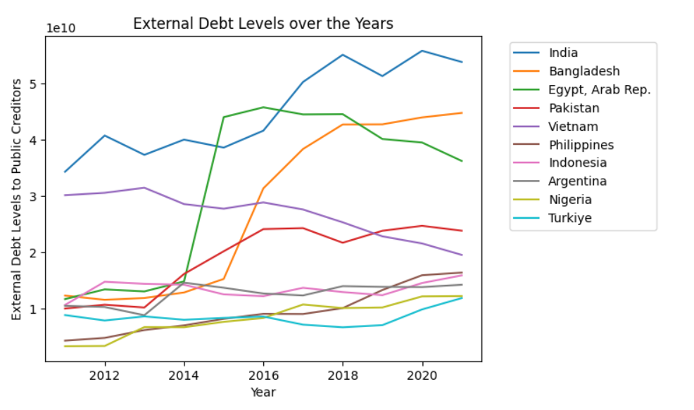
DATA ANALYSIS – QUESTION 1:
Which 10 countries have the highest levels of foreign debt?
This graph plots debt that is owed to public creditors (government bodies) over time from the respective countries highlighted in the legend
many of the listed countries have seen an increase in debt levels over time
Stand outs:
India
Bangladesh
Egypt
Vietnam

Slide 16
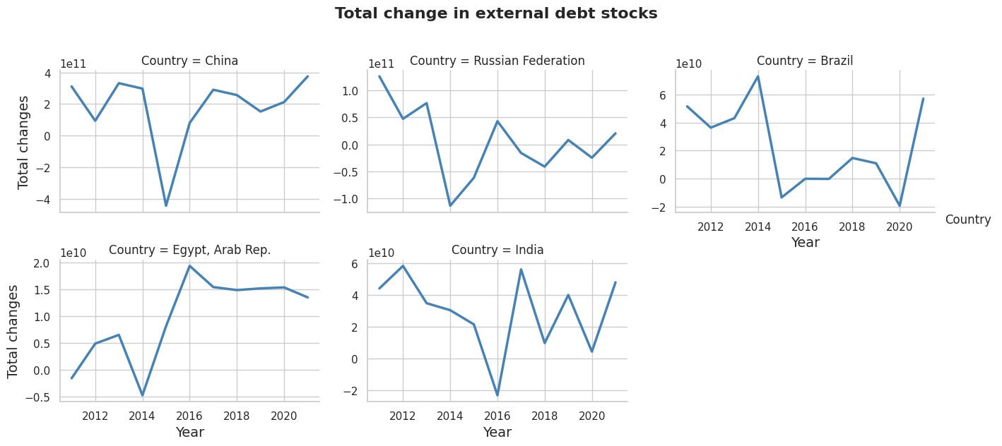
DATA ANALYSIS – QUESTION 2:
What are the topmost countries in each region that have the highest total change in external debt stocks in 2021 and how was the trend for this amount in these countries in the past 10 years?
Analysis was done on the variation in debt stock between consecutive years in current U.S. dollars.
The focus was on the region with the highest amount of debt in 2021.
Facet line graphs were created for each country to show the trend between 2011 and 2021.
China had the highest amount of variation in debt stock in 2021 and Egypt, Arab Rep had the lowest.
All countries experienced minus the total change in debt stock between 2014 and 2018, but in different years.
The amount of total change in debt stock fluctuated for China, Brazil, and India in the past 10 years but didn't change much in 2021 compared to 2011.
The variation in debt stock decreased for Russian Federation and increased for Egypt, Arab Rep in 2021 compared to 2011.
Russian Federation had a good policy implementation in debt stock reduction while Egypt, Arab Rep didn't.

Slide 17
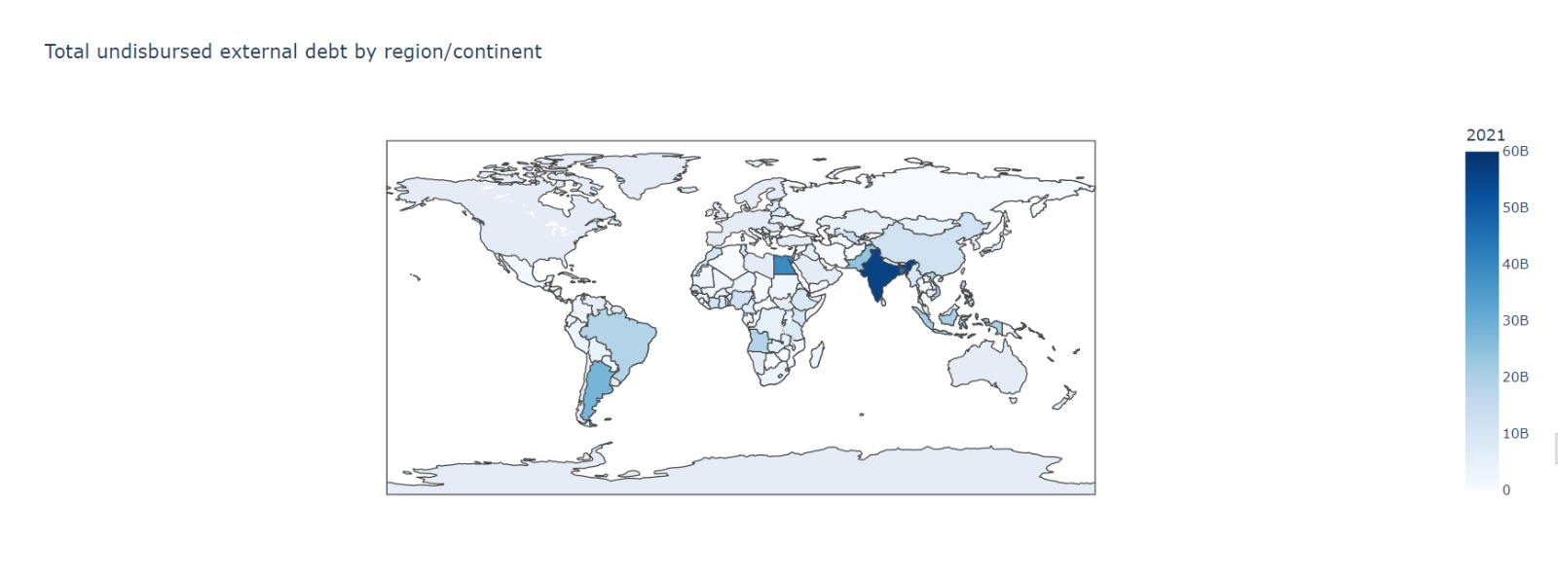
DATA ANALYSIS – QUESTION 3:
Geographical map to determine which regions look to be in the worst/best positions in terms of total undisbursed debt:
Countries in the region of South Asia seem to have the highest debt levels
What is the overall current state of each region’s economy in terms of debt levels?

Slide 18
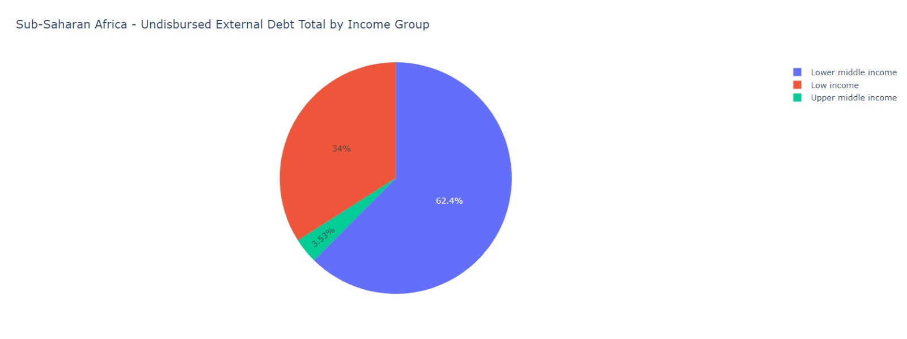
DATA ANALYSIS – QUESTION 3:
Latin America and Caribbean is the most successful region in terms of income levels

Slide 19
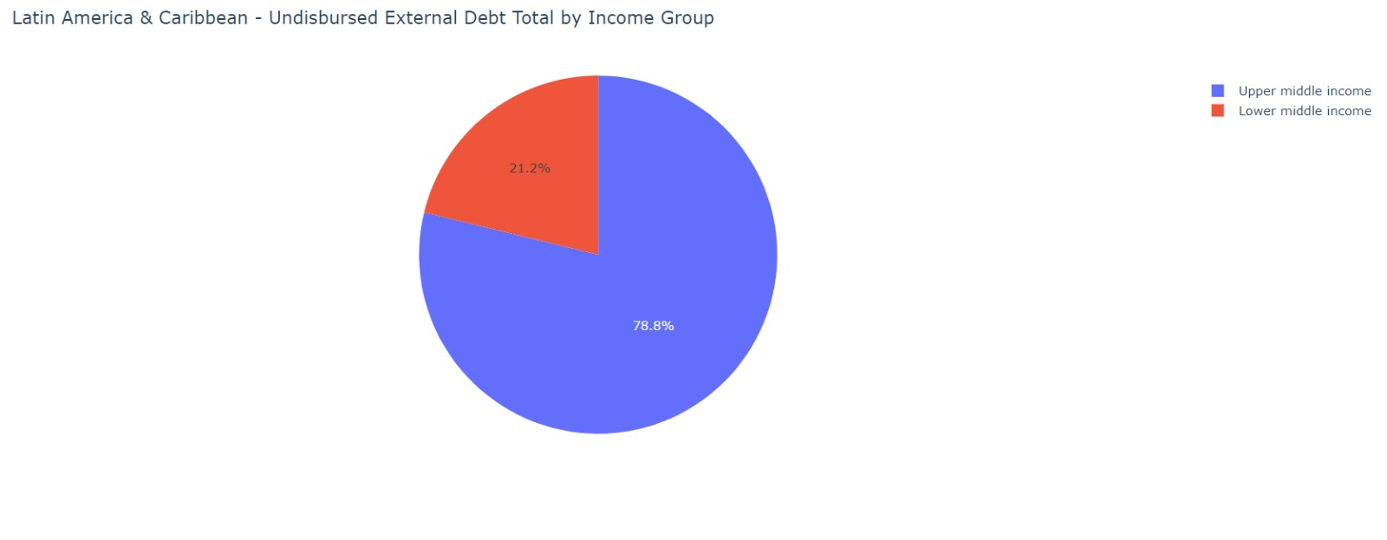
DATA ANALYSIS – QUESTION 3:
Sub-Saharan Africa has the largest income disparity between its countries

Slide 20

DATA ANALYSIS – QUESTION 4:
What countries (if any) are at risk of taking on too much foreign debt?
When attempting to complete this visualization, we noticed that many of the values were filled with NAs. When we started the data cleaning process, we chose not to remove the rows with NA values because of the type of dataset that we are working with
Did not want to make the mistake of removing a whole row if the data was missing from only one year.
Issue:
Since the type of debt that we were going to use to analyze whether a country would be at risk of taking on too much foreign debt could not be used due to the lack of data, we decided to use a different variable and amend the type of debt to analyze a similar metric.

Slide 21
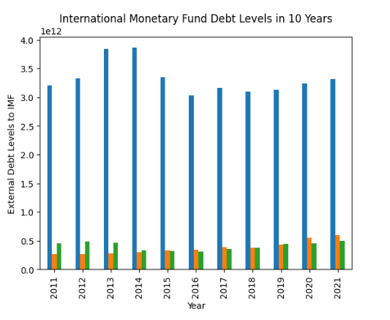

DATA ANALYSIS – QUESTION 5:
What countries, (if any) have relied the most on the International Monetary Fund to assist with their levels of debt in the past 10 years?
China:
assist in expanding its infrastructure and strengthening its economy.
Additionally, lower levels of external debt owed to public creditors
highest levels of reserves set aside.
India:
Top country for external debt funds owed to public creditors
Not financially stable enough to support itself solely through private and public creditors
The Russian Federation:
Number of tariffs
Very independent country

Slide 22
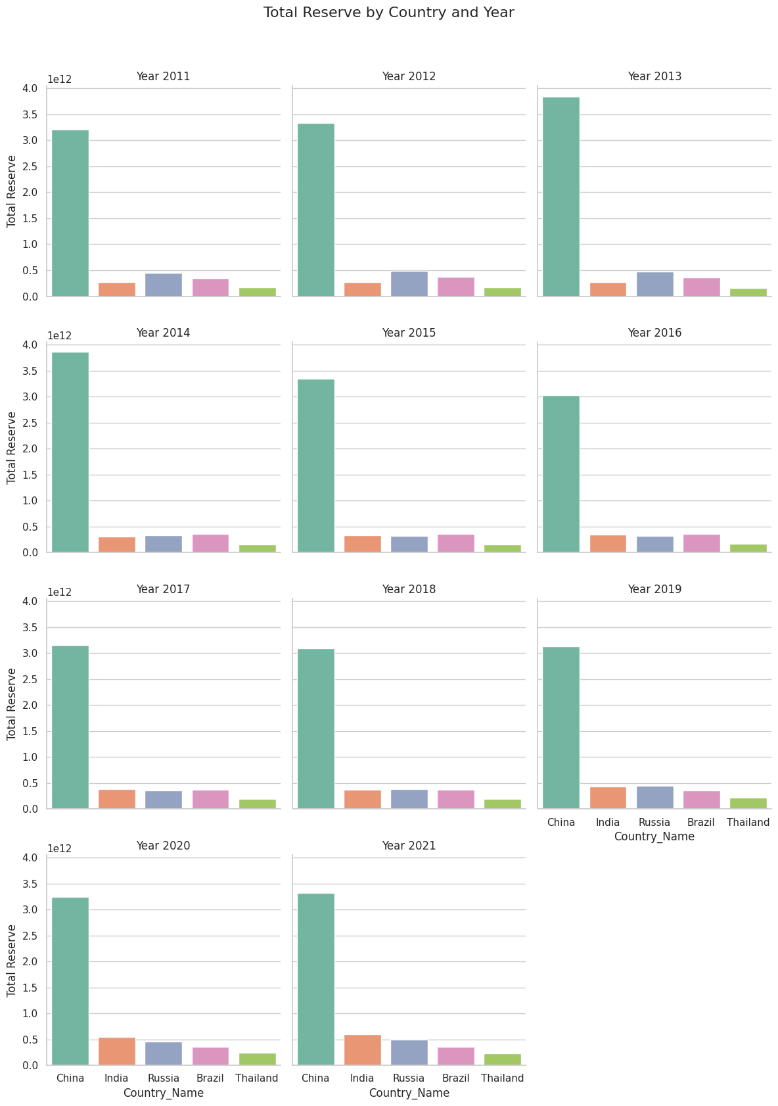
DATA ANALYSIS – QUESTION 6:
Which countries have the highest levels of reserves set aside for debt protection, if needed?
China:
Highest level of reserves set aside
Infrastructure and economic expansion
Beneficial to members of society
Other upper-middle income countries:
Reserves are much smaller
Size of economy could be a factor, however, the difference is substantial
Overall:
- Reserve levels align with each country’s economic performance and follow a similar pattern to its respective IMF levels.

Slide 23
CONCLUSION
India has the highest levels of external debt that are continually increasing
Changes in debt stocks revealed that higher income-earning countries were able to adapt better after 2020
Sub-Saharan African region had the highest level of income disparity
China borrows significantly more from the IMF in comparison to private or public creditors
The Russian Federation has the most reserves set aside
Sanctions placed on their country – reserves ensure that they have enough liquidity

Slide 24
Recommendations
Investments in infrastructure will increase economic growth, and consequently, GDP
Unprecedented decisions made in 2020
Additional funds were withdrawn from countries that were taking loans from high-income countries
Ensure that there are enough reserves set aside in an emergency response fund
Low-income countries should increase their borrowing with the IMF
Offers lower rates
China should consider diversifying its portfolio to keep it balanced
Take all other factors into consideration, not just the variables on paper

Slide 25
Thank you!

